Slide 1


Detecting Fake Jobs Postings Using Machine Learning
IS670 – Machine Learning for Business Analytics
Professor: Dr. Mostafa Amini

Slide 2

Team Members
Antariksh Ramesh
Prithviraju Venkataraman
Achyuth Sambaraju
Shreya Shree Bukkarayasamudram

Slide 3


Contents
Introduction
Objectives and Expectations
Definitions
Dataset overview and Target variable
Data Visualizations
Classification models
Key Outcomes
Conclusion

Slide 4

Introduction
In an era where online platforms dominate the recruitment landscape, the surge in fake job postings has become a critical challenge. These deceptive listings pose significant risks, including financial losses and privacy breaches, affecting both job seekers and reputable employers.
Our initiative focuses on addressing this challenge by harnessing the power of machine learning. We've developed a sophisticated model capable of distinguishing between genuine and fraudulent job postings with high precision. Our approach leverages advanced data analytics to strengthen the integrity of online job markets, thereby fostering a secure and reliable environment for all users.
Throughout this presentation, we will delve into the methodologies we employed, the dataset insights, our model's architecture, and the significant outcomes of our efforts.
APPLY

Slide 5

Objectives
Predictive Modeling and Analysis
Methodology and Technique Evaluation
Optimization and Performance Metrics
Insights and Business Impact
2
3
1
4
JOBS

Slide 6

Expectations
Reduction of Fraudulent Listings
Drastically decrease fraudulent job postings, reducing risks such as identity theft.
Support legitimate businesses in safeguarding their reputations from fraudulent associations.
Strengthen the overall reliability and security of online job markets.
Enhance the trust and usability of online recruitment platforms for
all users.
Impact on the Recruitment Industry
Generate actionable insights and methodologies and practical understanding
of fraud detection.
Inspire further research and development in applying data science to solve real-world security challenges.
Advancement in Fraud Detection Technology
Establish new benchmarks for machine learning effectiveness in fraud detection.
Encourage the integration of advanced fraud detection technologies across online platforms.
Contribution to the Field of Data Science

Slide 7
Definitions
Support
It refers to the number of actual occurrences of the class in the specified dataset. It provides insight into the evaluation of the performance metrics, showing how many instances are used to calculate the metrics for each class.
Precision
A metric used in classification tasks to measure the accuracy of the positive predictions. Precision indicates how many of the items that the model predicted as positive are positive.
Recall
Confusion Matrix
A tabular visualization of the performance of a classification algorithm. It shows the number of correct and incorrect predictions made by the model compared to the actual classifications in the data, broken down by each class.
It measures the ability of a model to find all the relevant cases within a dataset. Recall assesses the model's capability to correctly identify all actual positives.
F1 Score
Hyperparameter Tuning
It is the process of finding the most optimal set of parameters for a machine learning model, usually done through various search techniques (like grid search or random search).
The F1 Score is the harmonic mean of precision and recall, used as a single metric to provide a balance between precision and recall in models where both metrics are crucial.

Slide 8

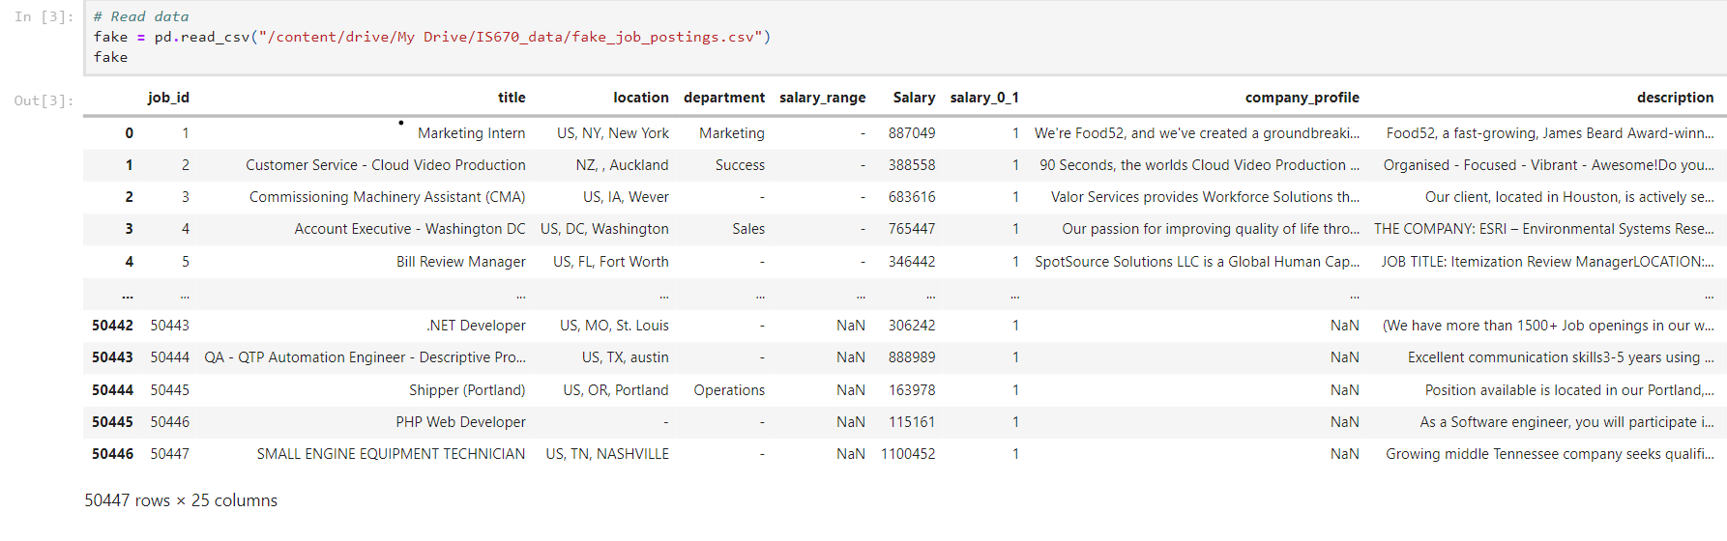
Dataset Overview
Dataset Overview
Our project utilizes the "Fake Job Postings Dataset," which contains data on various job listings, including both
genuine and fraudulent postings. Key features of this dataset include:
Job Title: The title of the job position.
Company Profile: Information about the company offering the job.
Description: A detailed description of the job and responsibilities.
Location: The location of the job.
Salary: Salary of that particular job ID.
Funtion: The type of functioning the job posting is about.
Requirements: Qualifications and skills required for the job.
Employment Type: The nature of the employment (e.g., full-time, part-time, contract).
Fraudulent: A binary variable indicating whether the job posting is real (0) or fake (1).

Slide 9

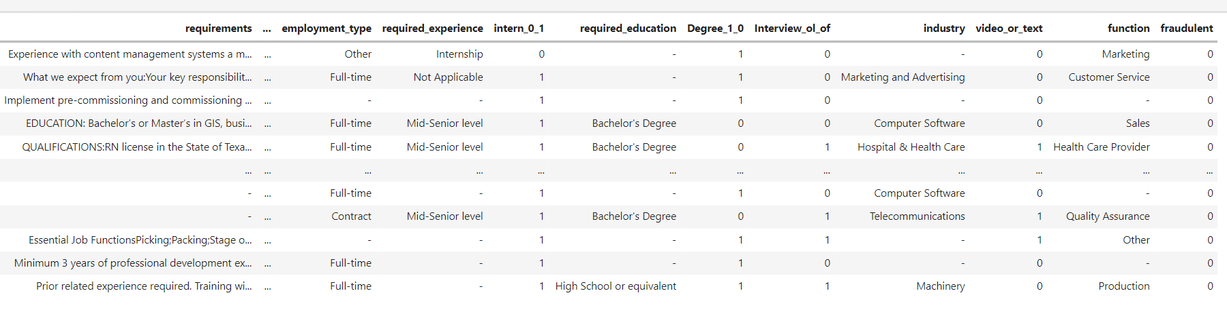
Target Variable
The dataset in discussion serves as a tool for identifying fraudulent job postings, a significant challenge in online recruitment platforms. Among these are unique identifiers such as job_id, categorical details like title, location, department, employment_type, required_experience, required_education, industry, and function.
The binary target variable fraudulent is marked with 1 for fake postings and 0 for legitimate ones, enabling supervised learning algorithms to discern patterns and anomalies associated with job scams. This robust combination of textual and categorical data points allows for the deployment of various classification models that can help job seekers and platforms filter out deceptive listings and maintain the integrity of the job market.

Slide 10

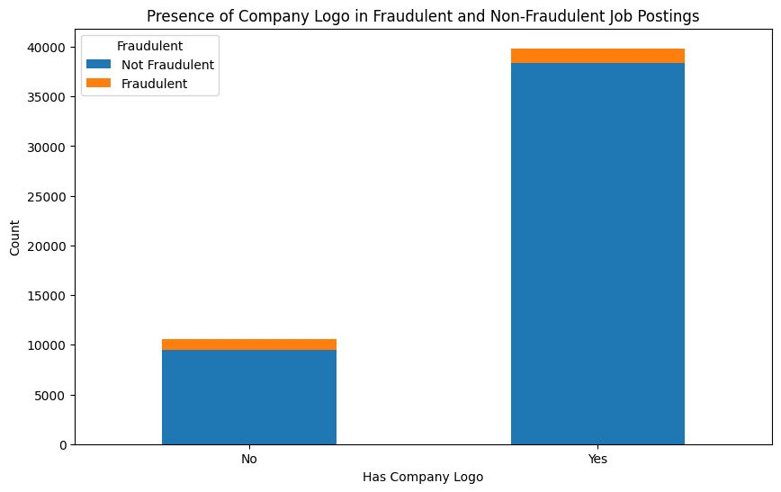
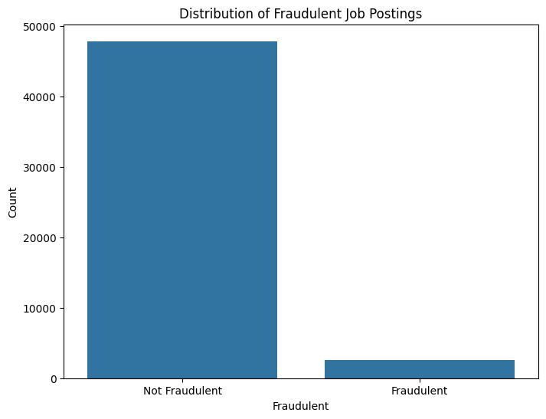
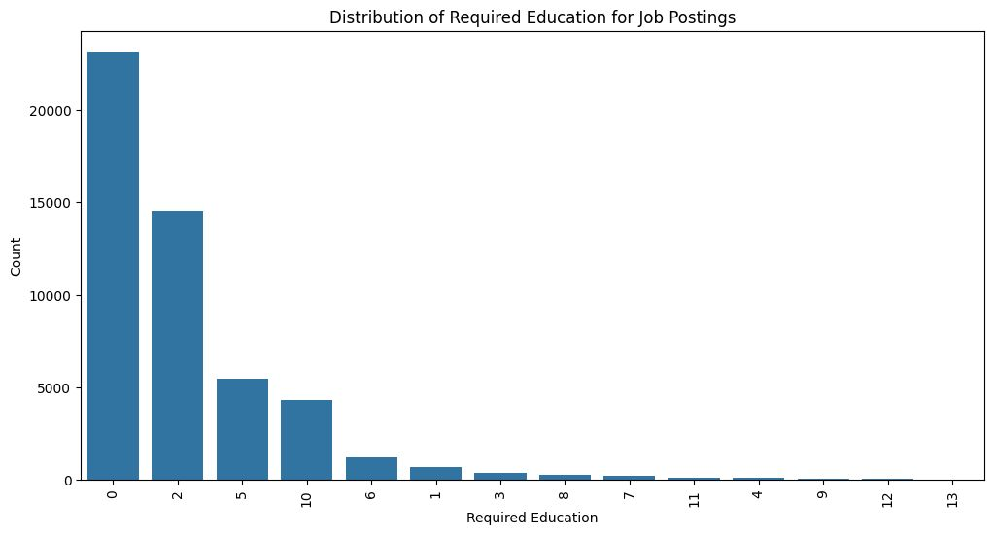
Data visualization
The below chart shows the number of job postings categorized by the level of education required. The x-axis numbers likely represent different levels of education, with the y-axis showing how many job postings require each level. Most postings require lower levels of education, with fewer postings as the education requirement increases.
This bar chart illustrates the presence or absence of a company logo in job postings and how it correlates with them being fraudulent or not. Most of both fraudulent and non-fraudulent postings have a company logo, but a significant portion of non-fraudulent postings also does not have a logo.
The above chart compares the number of fraudulent job postings to non-fraudulent ones. Most job postings are not fraudulent, with only a small portion being classified as fraudulent, as shown by the much smaller bar.

Slide 11
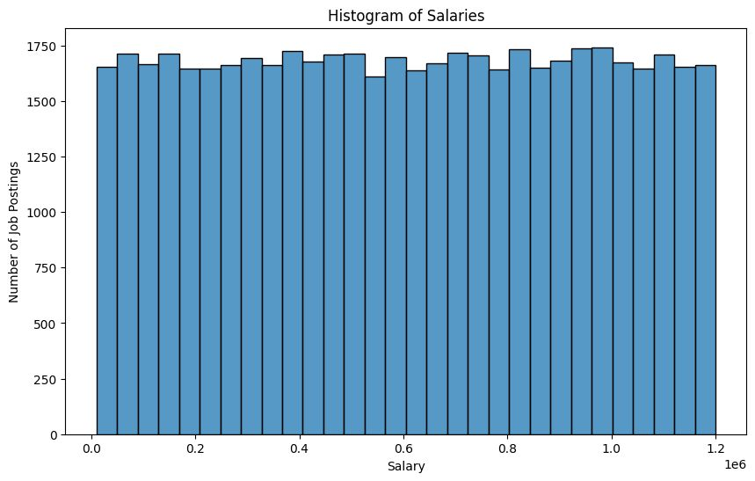
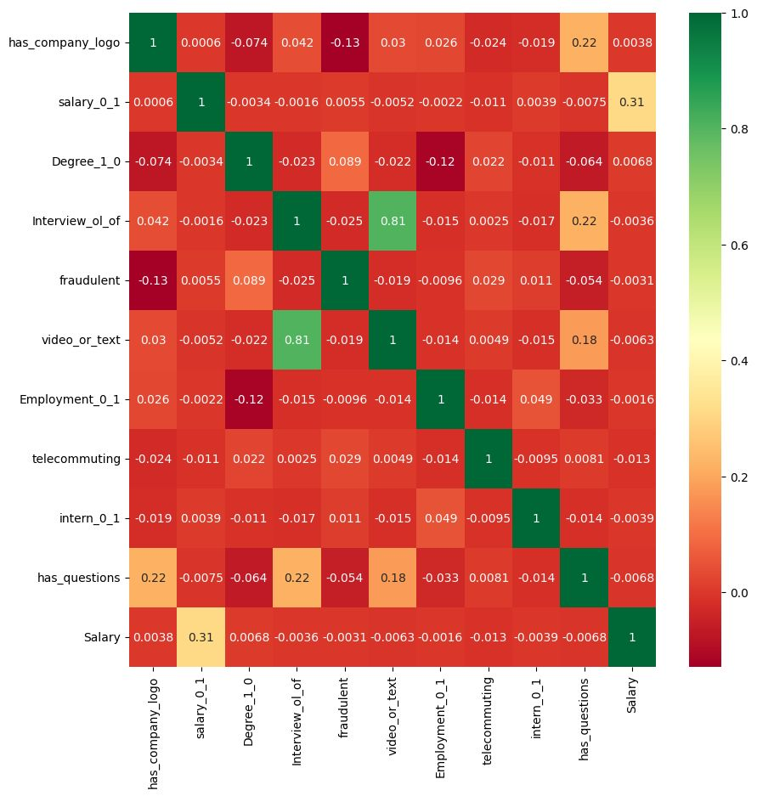
Data visualization
This histogram displays the distribution of salaries across job postings. The x-axis represents salary ranges, and the y-axis shows the number of job postings within each salary range. The graph indicates a relatively uniform distribution across various salary levels.
This heatmap shows the correlation coefficients between different features in a dataset, such as whether a company has a logo, the salary range, degree requirements, etc. Each cell's color intensity indicates the strength and direction of the correlation, with red representing a positive correlation, green a negative correlation, and values closer to 1 or -1 indicating stronger correlations.

Slide 12
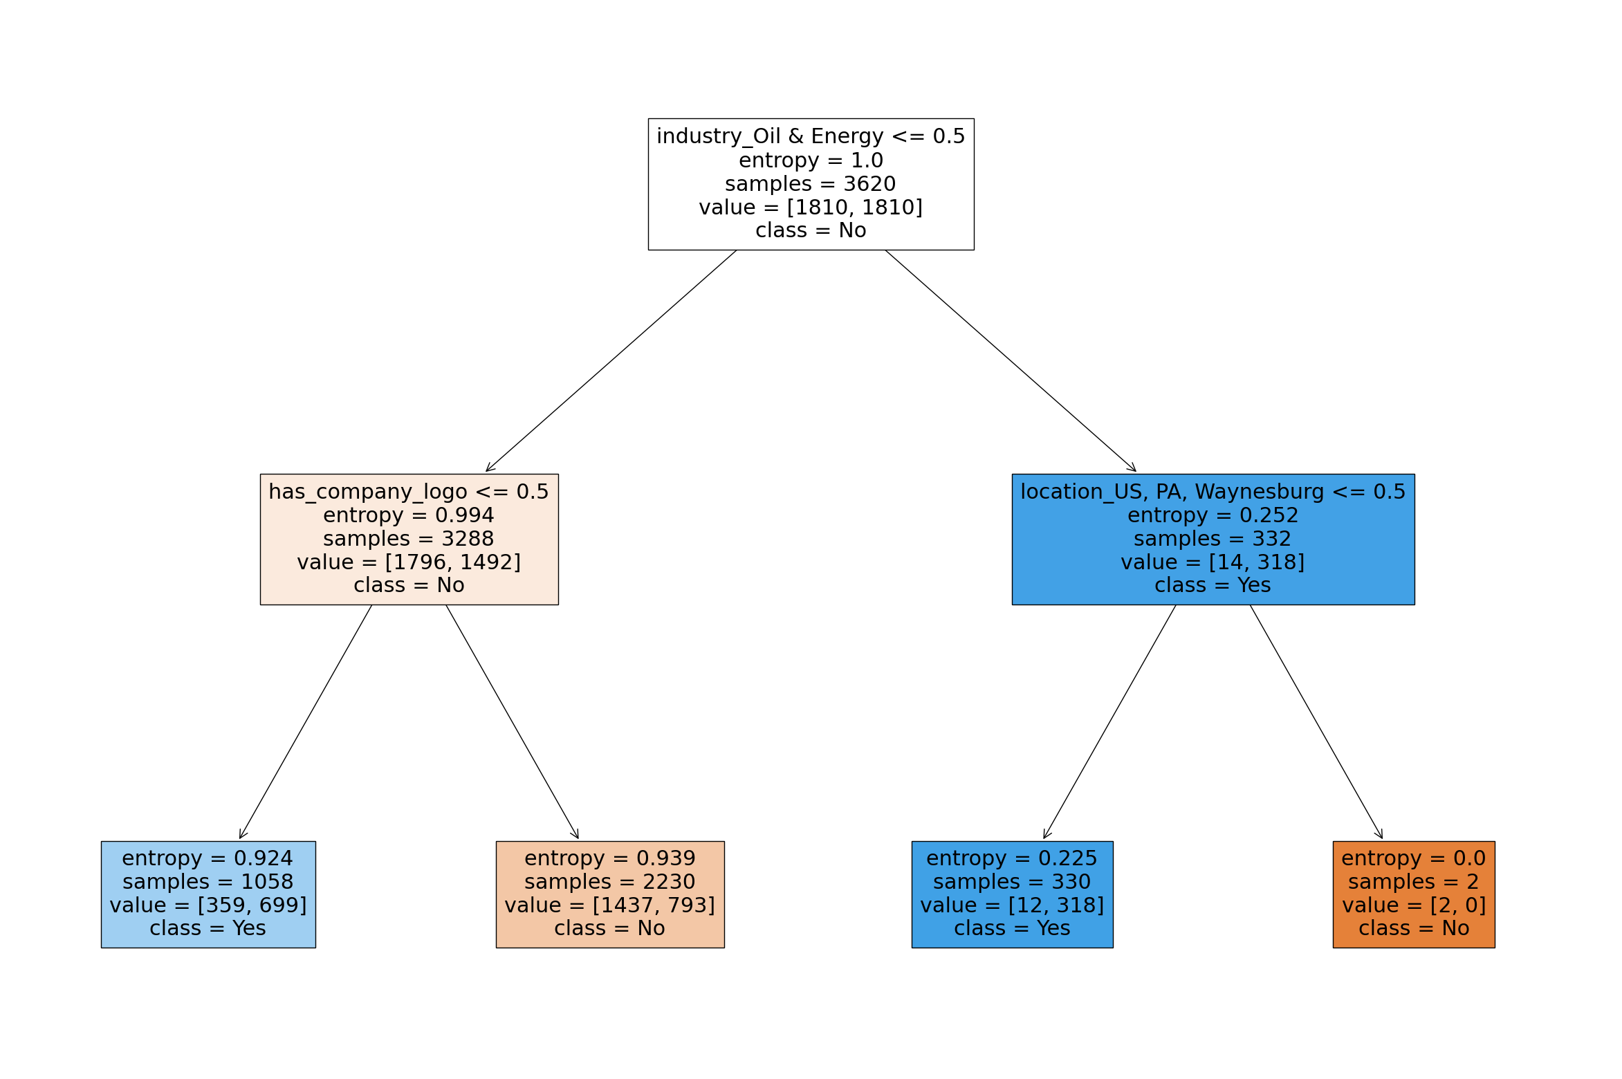
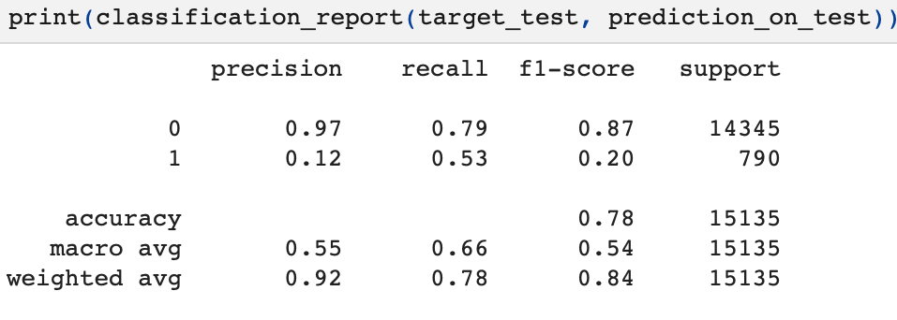
Decision Trees
Decision trees are non-parametric supervised learning models used for classification and regression tasks. They recursively partition the feature space into regions, with each partition representing a decision rule based on feature values. These models are represented as hierarchical trees, where internal nodes represent decision points based on feature values, and leaf nodes represent the predicted class or value.
Analysis:
In comparing three decision tree models for detecting fraudulent job postings, we found that Model 1, with a max depth of 2, showed good generalization with slightly higher testing accuracy than training.
Model 2, with max depth 5, demonstrated optimal generalization with higher testing accuracy.
However, Model 3, with max depth 8, showed a slight decrease in testing accuracy, indicating potential overfitting.
Overall, Model 2 appears the most effective, balancing complexity and performance for practical deployment.

Slide 13
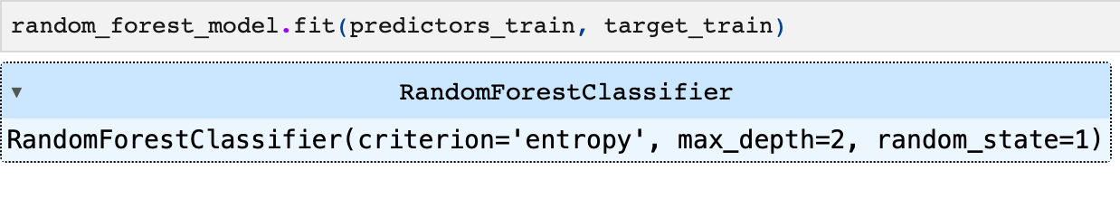
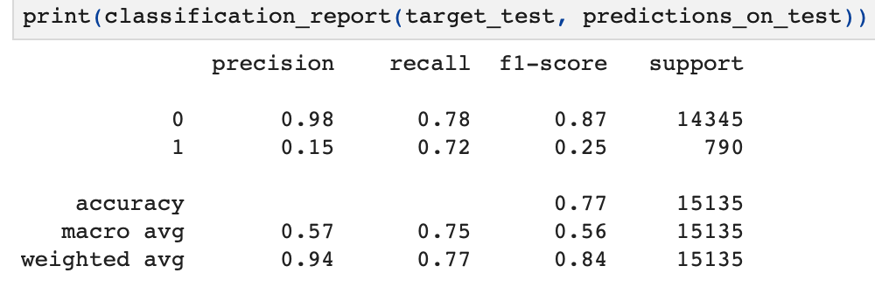
Random Forest Classifier
A Random Forest classifier is a robust machine learning algorithm used for classification by constructing multiple decision trees during training and outputting the mode of their classes as the final prediction. It employs ensemble learning, enhancing accuracy and stability by averaging multiple models. The algorithm introduces randomness by selecting different subsets of data and features for each tree, reducing the risk of overfitting. Random Forest is versatile, used for both classification and regression tasks, and is noted for its ease of use and effective handling of various types of data.
Analysis:
By our analysis we found out that this model has a high overall accuracy driven mainly by its strong performance in identifying non-fraudulent cases but struggles significantly with fraudulent cases.
Poor Fraud Detection: The model's ability to detect fraudulent cases is limited, indicating that it fails to identify many actual fraudulent instances.

Slide 14
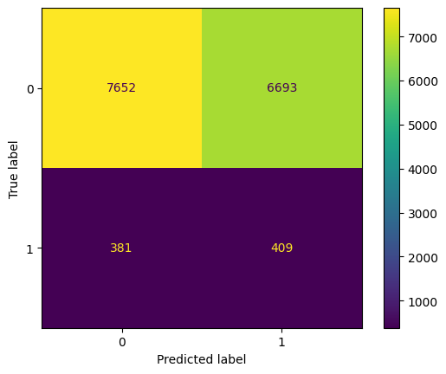
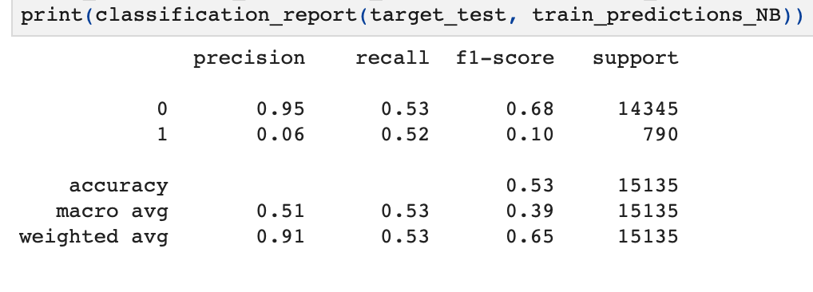
Naïve Bayes
Naive Bayes is a probabilistic supervised learning algorithm based on Bayes' theorem with the "naive" assumption of feature independence. It's commonly used for classification tasks. Despite its simplifying assumptions, Naive Bayes often performs well in practice, particularly on text classification tasks. It calculates the probability of a given instance belonging to each class based on the feature values and selects the class with the highest probability.
Analysis:
The model demonstrates high precision for non-fraudulent predictions with true negatives and true positives, indicating a balanced performance in detecting non-fraudulent cases.
The overall accuracy of the model stands very low, reflecting significant challenges in effectively classifying both fraudulent and non-fraudulent cases accurately.
The confusion matrix indicates 381 false positives, where non-fraudulent cases are mistakenly flagged as fraudulent, and 409 false negatives, where fraudulent cases are mistakenly identified as non-fraudulent, showing a moderate error rate.

Slide 15

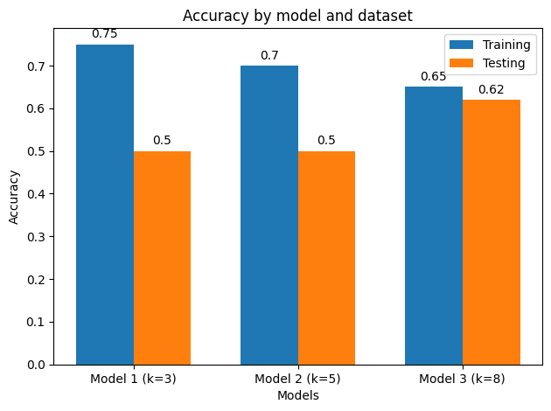
K- Nearest Neighbors
K-Nearest Neighbors is a non-parametric supervised learning algorithm used for classification and regression tasks. It classifies instances based on the majority class among their k nearest neighbors in the feature space. The choice of k, the number of neighbors, influences the model's bias-variance trade-off: smaller values of k lead to more flexible models, while larger values lead to smoother decision boundaries.
Analysis:
In comparing three models, we observe variations in their training and testing accuracies, with each model defined by different values of k.
Model 1, with k=3, demonstrates the highest training accuracy at 0.75, but shows a noticeable decrease in testing accuracy to 0.65. This suggests a potential overfitting, as the model performs well on the training data but less effectively on unseen testing data.
Model 2, with k=5, shows both training and testing accuracies at 0.5. This equal performance suggests that it generalizes effectively across different datasets, maintaining consistent performance from training to testing, and indicating a balanced fit.
Model 3, with k=8, has a training accuracy of 0.7 and testing accuracy of 0.62. The modest drop suggests it may be more robust against overfitting compared to Model 1.

Slide 16

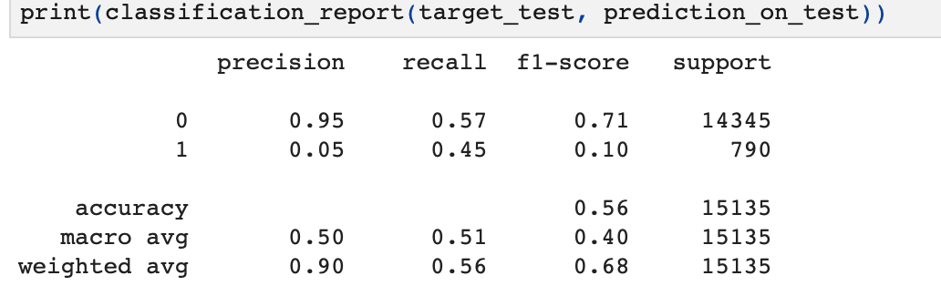
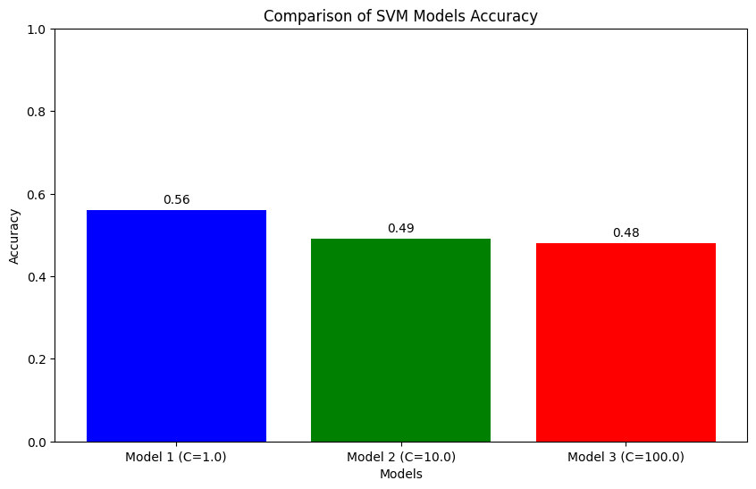
Support Vector Machines (SVM)
Support Vector Machines are supervised learning models used for classification and regression tasks. SVMs aim to find the hyperplane that best separates the data points of different classes while maximizing the margin, the distance between the hyperplane and the nearest data points (support vectors). SVMs are effective in high-dimensional spaces and can handle non-linear decision boundaries through kernel functions, mapping the input space into a higher-dimensional feature space.
Analysis:
The model shows high precision (0.95) in predicting non-fraudulent cases but has a lower recall (0.57), indicating it misses a significant number of actual non-fraudulent cases. It struggles more with fraudulent cases, reflected by a low precision (0.05) and moderate recall (0.45), indicating frequent misclassifications.
The overall accuracy of the model stands at 0.56, and the macro-average F1-score of 0.40 suggests significant room for improvement in handling complex classifications effectively.

Slide 17
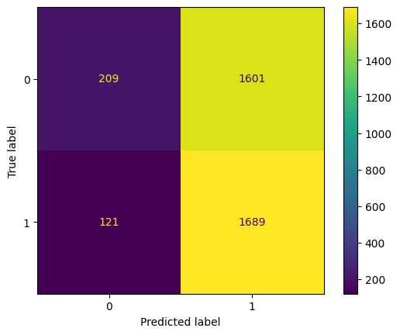
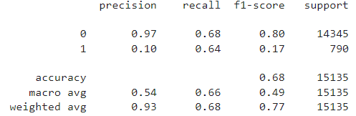
Multilayer Perceptron (MLP)
A Multilayer Perceptron (MLP) is a type of artificial neural network used for supervised learning tasks like classification and regression. It consists of multiple layers of interconnected neurons, including an input layer, one or more hidden layers, and an output layer. Each neuron applies an activation function to a weighted sum of its inputs, allowing the model to learn complex relationships between input and output variables.
Analysis:
The confusion matrix indicates that the model is performing substantially better in correctly predicting true positives and true negatives. The model demonstrates a strong ability to identify true positive instances and has a similar efficacy in recognizing true negative cases, with slightly less accuracy. Overall, the model shows a strong bias towards correctly identifying the positive class.
With a substantial recall rate for fraudulent cases, the model proficiently identifies most actual fraudulent instances, highlighting its effectiveness in detecting fraud.

Slide 18

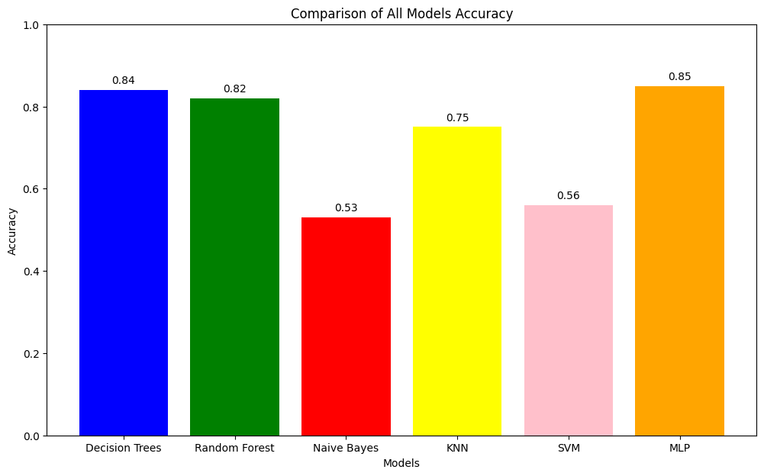
Comparisons
In comparing various machine learning models on the job listing dataset for fraud detection, we gained valuable insights. Decision Trees and MLP models excelled in accuracy, making them preferable for this application due to their effective handling of complex patterns. Conversely, Naive Bayes and SVM showed weaker performance, possibly due to deviations from their model assumptions in the dataset.
This analysis emphasizes the importance of selecting models carefully based on data characteristics and the need for continual model refinement. Enhancing models through feature engineering or integrating sophisticated ensemble methods could further improve our fraud detection capabilities in job listings. This project not only informs effective model selection but also illustrates the dynamic nature of machine learning in adapting to varied data sets.

Slide 19
Key outcomes
Versatility and Adaptability of Models:
High Precision in Non-Fraudulent Identification:
The diverse array of machine learning models tested, from Decision Trees to Naive Bayes, demonstrates the adaptability and potential of these tools to be fine-tuned for specific tasks, paving the way for tailored solutions that enhance online job market integrity.
The models consistently achieve high precision rates for non-fraudulent job postings, effectively safeguarding the legitimacy of genuine listings and supporting reputable businesses.
Enhancement of Online Job Market Security:
Significant Progress in Fraud Detection:
Certain models, particularly the Multilayer Perceptron and Random Forest, have shown commendable success in detecting fraudulent postings, highlighting the capabilities of machine learning to address complex challenges in fraud detection.
The application of machine learning models has significantly contributed to strengthening the security and trustworthiness of online job platforms, reducing the risks associated with fraudulent job postings and enhancing the overall user experience for job seekers.

Slide 20
Conclusion
The initiative to use machine learning for detecting fraudulent job postings has demonstrated considerable potential, with certain models providing robust detection capabilities.
1
JOBS
The integration of these technologies not only supports the integrity of online job markets but also provides a foundation for future advancements in machine learning applications in fraud detection.
2
This project highlights the essential role of advanced data analytics in addressing real-world problems like job fraud. The insights derived from data visualization and machine learning model analysis demonstrate the power of data-driven approaches to enhance decision-making and improve security measures in online recruitment platforms.
3

Slide 21
THANK YOU

